Slide 1

MSK care Pathways
Dr Khaled Afifi (PhD and M. Ost)
First Contact Physiotherapist
Registered Physiotherapist and Osteopath

Slide 2




Learning Outcome:
Describe the structure of MSK clinical pathways in the UK.
1
Explain referral processes, triage systems, and the role of APPs in MSK pathways.
2
Recognise red flag presentations and understand their impact on clinical decision-making and referral urgency.
3
Evaluate the importance of interprofessional collaboration and communication within MSK care pathways.
4
Reflect on the influence of clinical pathways on patient experience, accessibility, and continuity of care.
5
Understand how national guidelines inform MSK clinical pathways and physiotherapy practice.
6

Slide 3
FIT FOR THE FUTURE 10 Year Health Plan for England
hospital to community:
analogue to digital.
sickness to prevention.

Slide 4
hospital to community:
the neighbourhood health service, designed around you.
end the disgraceful spectacle of corridor care and restore the NHS constitutional standard of 92% of patients beginning elective treatment within 18 weeks.
free up hospitals to prioritise safe deployment of AI and harness new technology to bring the very best of cutting-edge care to all patients. All hospitals will be fully AI-enabled within the lifetime of this Plan.

Slide 5
From analogue to digital: power in your hands
By 2028, the NHS app will be a full front door to the entire NHS. Through the app, patients will be able to:
get instant advice for non-urgent care and help finding the most appropriate service first time, through My NHS GP.
manage a long-term condition through My Care, access and upload health data through My Health or get extra care support through My Companion.
build ‘HealthStore’ to enable patients to access approved digital tools to manage or treat their conditions, enabling innovative businesses to work more collaboratively with the NHS and regulators.

Slide 6
From sickness to prevention: power to make the healthy choice People
encourage citizens to play their part, including through a new health reward scheme to incentivise healthier choices. We will also work with the Great Run Company to set up a campaign to motivate millions to move more on a regular basis

Slide 7
An NHS workforce, fit for the future
make AI every nurse’s and doctor’s trusted assistant - saving them time and supporting them in decision making. Over the next 3 years we will overhaul education and training curricula with the aim of future-proofing the NHS workforce.

Slide 8
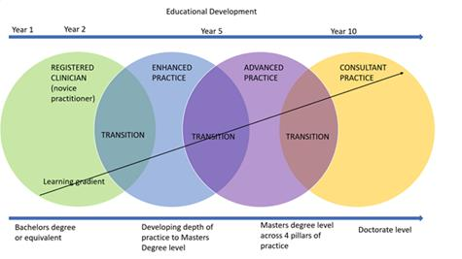
Educational development

Slide 9
Group work
In 5 minutes.
What does MSK triage mean? What is the benefit of triage?

Slide 10
MSK triage:
The goal of the diagnostic triage for MSK patients is to exclude non-MSK causes of pain. A focused history and a physical examination of the patient form the cornerstone to the diagnostic triage classification. Part of the consultation should be used to gauge the patient’s understanding of their pain (ICE) (Bardin et al., 2017).
Triage systems are implemented to reduce waiting times and ensure rapid access to effective assessment, advice and treatment. As a result, the effects of triage on waiting list time , satisfaction, diagnostic agreement , appropriateness of referral , clinical measures and cost have been evaluated (Joseph et al., 2014).

Slide 11
MSK triage (continued):
Evidence suggests that advanced practice physiotherapists (APPs) demonstrate good to very good agreement with physicians in both diagnosis and surgical triage of musculoskeletal disorders. Moreover, patients managed within an APP model of care report clinical outcomes—such as reductions in pain and disability—that are comparable to, or in some cases better than, those achieved with usual medical care (Lafrance et al., 2023).

Slide 12
Clinical Reasoning:
a complex interaction of knowledge, clinical data, experience and patient understanding. As clinicians, we are asking questions of our patients, ourselves and the literature to help construct a clinical diagnosis and formulate a treatment plan (Roberts & Langridge, 2018).

Slide 13
What did we cover so, far ☺
NHS 10 Year Health Plan for England
MSK Triage
Clinical reasoning

Slide 14
Practical
A group of 3: patient, physio and examiner.
1- are you going to to treat this patient? Why?

Slide 15
Red flags:
"positive answers to key questions about medical history, that indicate the possibility of a serious underlying condition" (Underwood & Buchbinder 2013).
Not intended to be clinical decision-making tools in their own right
Inadequate evidence to support the use of red flags as a screening tool to decide whether or not further investigations are needed
Need a better understanding about which red flags are predictive of serious pathology in order to reduce unnecessary investigations
Single red flags are not diagnostic, clusters of red flags may have better prognostic utility and should be used in context of a thorough subjective patient history and physical examination
Need to think in terms of how a serious pathology may present clinically, and which red flags would be relevant for that specific pathology

Slide 16
Red flags continued:
Subjective, subjective, subjective
Onset, duration, nature, daily pattern, aggravating factor, reliving factor.
Chronology of symptoms.

Slide 17
MSK Masqueraders:
attribute a patient’s symptoms to an unrelated entity (Walcott et al., 2011).
Vascular Masqueraders.
Neurological Masqueraders.
Visceral Masqueraders.
Others.

Slide 18

Break
5 minutes

Slide 19
clinical practice pathways (CPWs):
structured multidisciplinary care plans which detail essential steps in the care of patients with a specific clinical problem (Rotter 2010). They support the translation of clinical guidelines into local protocols and clinical practice (Campbell 1998). Whilst clinical guidelines provide generic recommendations, CPWs detail the local structures, systems, and time frames to address these recommendations.
CPWs have been proposed as a strategy to optimize resource allocation in a climate of rising healthcare costs, as they may improve the efficiency with which healthcare is delivered

Slide 20
Benefits of clinical practice pathways (CPWs):
Stand-alone CPWs are likely to reduce in hospital complications (moderate certainty) but it is very uncertain if they make any difference to hospital readmissions (up to 6 months) (very low certainty). Stand-alone CPWs are likely to reduce length of hospital stay (moderate certainty). Costs and charges were generally lower in CPWs in nine out of ten studies included in this comparison (very low certainty). Stand-alone CPWs may also slightly increase adherence to recommended practice (low certainty) (Rotter et al., 2025).

Slide 21
CPWS (continued):
purpose of the Pathway:
•Implement Evidence Based Pathway.
•Expedite Effective Treatment.
•Reduce Inappropriate Referrals to Secondary Care.
•Eliminate Ineffective Therapies.
•Reduce Case-mix Variation .
•Address Surgical Waiting Times.
•Drive up Quality of Care.
•Improve Patient Outcomes and Satisfaction.
MSK triage:
The goal of the diagnostic triage for MSK patients is to exclude non-MSK causes of pain.
Triage systems are implemented to reduce waiting times and ensure rapid access to effective assessment.
advice and treatment.
As a result, the effects of triage on waiting list time , satisfaction, diagnostic agreement , appropriateness of referral , clinical measures and cost.

Slide 22




Musculoskeletal: Osteoarthritis (OA) clinical guidance- hip and knee within primary and community care
Initial presentation in primary care | Confirmation of diagnosis/initiation of treatment in primary and community care | Conservative management in primary and community care | Initial presentation for clinical triage and assessment by integrated tier 2 MSK service/SPOA | Review in primary and community care | MSK Specialist review | Surgical review and assessment in secondary care
Shared decision making should occur at each decision point across the pathway
Self referral
Primary Care:
GP, MSK Specialist Doctor, FCP
ED/111
Other non-MSK/ MSK specialist HCP
SPOA/Tier 2 MSK service referral
Red Flags
Trauma & Orthopaedic, rheumatology, spine or pain referral with full patient medical history
Clinical assessment and screening for serious pathologies. Exclude red flags
Imaging is not indicated at this stage unless symptoms are unusually severe. Consider using iRefer
Clinical triage at SPOA
Review investigations and progress
Refer to pain management/Combined Physical and Psychological Programme (CPPP) / MDT as appropriate
1st presentation in primary care:
Over 45, activity related joint pain, No morning joint-related stiffness >30 mins, impacts on daily activities and quality of life
When to refer
Conservative non-surgical management for period of up to 3 months
MDT management for complex cases
Timing of regular reviews for people with OA based on:
severe pain, more than one joint affected, comorbidities, on regular medication for pain
Link to GIRFT pathways, NICE guidance and best practice resources
Refer back to primary/community as needed
Consider alternative diagnosis if features do not fit OA diagnosis:
Atypical features such as a history of trauma, prolonged morning joint-related stiffness, rapid worsening of symptoms, presence of a hot swollen joint may indicate alternative or additional diagnoses.
Differential diagnoses includes gout, other inflammatory arthritides, septic arthritis and malignancy (bone pain).
Optimise patient for surgery and manage comorbidities:
Consider prehab referral, psychological support, pain management
Consider referral to primary/community care and 3rd sector/voluntary sector for ongoing management rehabilitation and support
Evidenced based investigations
Refer for injection/surgery if indicated
Refer for further opinion if indicated
Refer for further conservative treatment if indicated
Discharge if indicated
As part of shared decision making conversation:
Discuss options for onward referral. Consider use of decision support tools.
Discuss referral/self referral for conservative treatment /physiotherapy if not improving. If the patient is ready, consider a trial of appropriate conservative treatment, including strengthening and aerobic exercise, but consider referral if symptoms worsening despite treatment
Consider onward referral to other specialities if symptoms not MSK in origin
Consider Patient Initiated Follow Up (PIFU)
Offer tailored written and verbal advice on the following core treatments to all people with clinical osteoarthritis:
Assess patient’s knowledge, skills and confidence: if low consider signpost/referral to health and well-being coach
Deliver consistent and concise health and wellbeing information and encourage patients to engage in conversations about their health
Access to quality self-management education and appropriate information to enable self-management
Tailored advice about how to: stay active, how to achieve weight loss if the person is overweight or obese, advice on smoking and alcohol consumption, use of appropriate footwear
Consider directing social prescriber to access voluntary/third sector, quality self-management resources, emotional/mental health wellbeing resources
Link to:
Outpatient transformation opportunities, relevant clinical standards and best practice resources
Outpatient digital opportunities, relevant digitally-enabled service case studies and best practice resources
MSK workforce opportunities across primary, community and secondary care settings
Engage with wider primary care team such as care coordinator, clinical pharmacist, health and wellbeing coach and social prescriber as needed
Consider paracetamol, topical NSAIDs, or if unsuccessful, NSAIDs and highly selective COX-2 inhibitors with PPI
Consider addition of opioids if the above unsuccessful
Consider Intra articular corticosteroid injections as an adjunct to core treatments for the relief of moderate to severe pain
Key:
Decision points
Holistic assessment including mental health, social and work status, sleep, weight, comorbidities, pain and function and collection of PROM and PREM data
Shared decision making conversations (including holistic assessment, understanding what matters to the person, discussion of appropriate treatment options and associated harms, benefits and consequences, values and preference) to take place at each decision point on the pathway, using relevant in consultation decision support tools. Discuss options for onward referral.

Slide 23
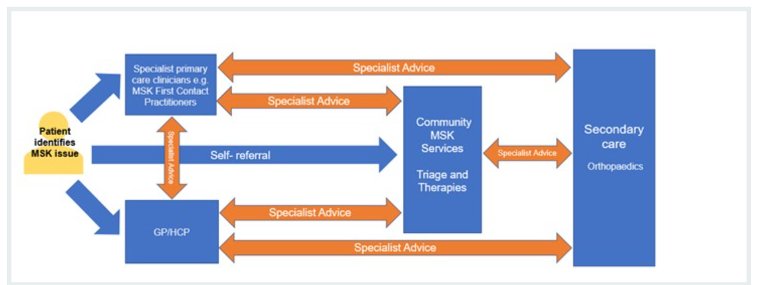
referral optimisation in adult services managing MSK conditions (NHS England, 2023)
:

Slide 24
CPWS (continued):
throughout England, many different services and many different pathways of care exist and so implementation of the National Pathway would be a decision for the CCGs, taking into account services and provision within their commissioning area

Slide 25
It is evident that, despite differences in care pathways, some patients seen in physiotherapy clinics will still need a surgical opinion, while some patients referred to orthopaedic clinics will ultimately be better managed conservatively. This pattern occurs even with triage and referral systems designed to fast-track individuals to the most appropriate service (Button et al., 2019).

Slide 26
for ongoing treatment in a clinic, physiotherapists were more likely to give exercise and education at the time of consultation while a surgeon was more likely to refer to rehabilitation services (which would include exercise and education), adding a further step and potential delay in the patient receiving the correct care (Button et al., 2019).

Slide 27
Group work. MDT in MSK. Who is involved?
In 5 minutes

Slide 28
What else we need to consider?

Slide 29
Personalised care:
Personalised care means people have choice and control over the way their care is planned and delivered. It is based on ‘what matters’ to them and their individual strengths and needs.
This happens within a system that makes the most of the expertise, capacity and potential of people, families and communities in delivering better outcomes and experiences.

Slide 30
Shared Decision Making:
is a collaborative process that involves the patient/carer and their healthcare professional working together to reach a joint decision about care. To achieve this the patient/carer/family member needs to understand the risks, benefits and any consequences of the care management options available.

Slide 31
What else?
NHS England has produced decision support tools for Dupuytren’s contracture, carpal tunnel syndrome, hip osteoarthritis, knee osteoarthritis and chronic primary pain.
The MRI spinal leaflet for clinicians is aimed at reducing unwarranted variation in requests for MRI scans for spinal conditions and was developed by spinal clinicians in collaboration with lived experience partners. It supports clinicians when considering whether an MRI scan is appropriate. A patient leaflet is also available.

Slide 32
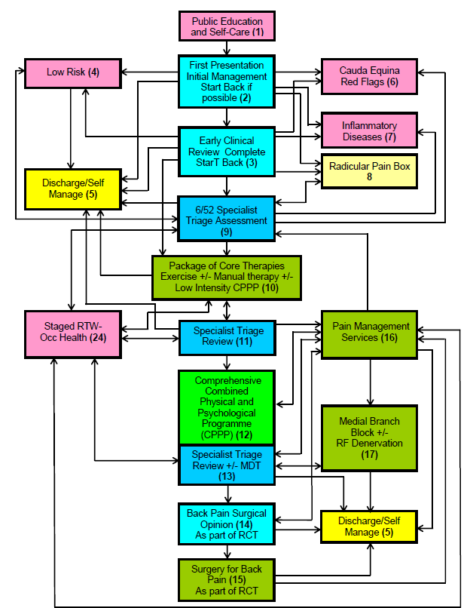
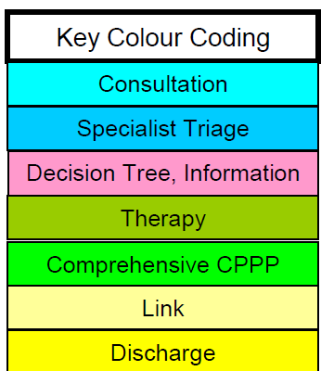
National Low Back and Radicular Pain Pathway 2017 (Excellence, 2017):

Slide 33
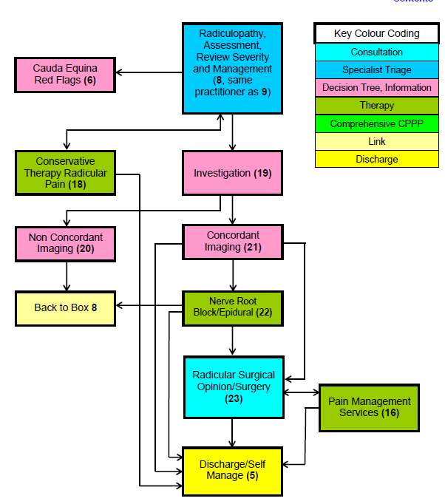
Radicular Pain Pathway

Slide 34
Urgent and emergency referral
Urgent and Emergency referral
Suspected pathology | Clinical features | Referral route
Malignancy/infection | Escalating pain and progressively worsening symptoms that do not respond to conservative management or medication as expected Night pain that prevents sleep due to escalating pain and/or difficulty lying flat Previous history of malignancy, especially breast, prostate, lung, thyroid and kidney Unexplained weight loss of more than 10% body weight in 3/12 Recent significant infection or travel in TB endemic country Systemically unwell (fever/rigors) Immunosuppression e.g. IV-DU, HIV) Limb weakness/gait disturbance For shoulder and upper limb conditions consider loss of sensation or power in the arm (reflecting brachial plexus involvement), or skin dryness, drooping eyelid and retraction of the eye (reflecting sympathetic nerve involvement) Consider visceral and neurological causes/manifestations of MSK conditions | Urgent referral to spinal service/2WW for suspected malignancy
Cauda equina syndrome or Possible unstable fracture or Acute spinal cord compression | Bladder/bowel/sexual dysfunction related to onset of spinal pain Saddle anaesthesia History of significant fracture or possible unstable fracture Obvious acute deformity Signs/symptoms of acute spinal cord compression Progressive significant leg weakness | Emergency referral to spinal or orthopaedic surgeon through local pathways
Pathological fracture | Sudden onset severe back pain, particularly thoracic, with/without minor trauma | X-ray affected area
Giant Cell Arteritis | Visual symptoms Diplopia; changes to colour vision; sudden visual loss (transient or permanent) GCA symptoms New onset headache; scalp tenderness; jaw or tongue claudication; temporal artery tenderness, nodularity or reduced pulsation Systemic symptoms Limb claudication; pain & stiffness in the shoulder and pelvic girdle; fever; sweats; weight loss NB. None of these symptoms is entirely specific for GCA & each is of ltd use if taken in isolation. Therefore, the differential diagnosis must also be considered | Refer as emergency to be seen same day by ophthalmology if new visual loss (transient or permanent) or double vision GCA strongly suspected* – initiate steroids immediately (40-60mg once daily as per local protocol) Refer as emergency to rheumatology to be seen ideally on the same day (in all cases within 3 days) Arrange urgent blood test (FBC, ESR, CRP) (*“strongly suspected” = in the assessing clinician’s judgement, GCA is a more likely explanation for the patient’s symptoms than any other condition)
Urgent and Emergency referral
Suspected pathology | Clinical features | Referral route
Suspected Axial Spondyloarthritis | Age at onset <40 Insidious onset Improvement with exercise No improvement with rest Pain at night (with improvement on getting up) NG65 Spondyloarthritis in over 16s: diagnosis and management Signs and symptoms suggestive of axSpA include a combination of: Low back pain that started before the age of 45 years and has lasted for longer than 3 months and 4 or more of the following additional criteria: low back pain that started before the age of 35 years waking during the second half of the night because of symptoms buttock pain symptoms that improve with movement symptoms that improve within 48 hours of taking non-steroidal anti-inflammatory drugs (if tolerated) a first-degree relative with spondyloarthritis current or past arthritis current or past enthesitis current or past psoriasis Alternatively, 3 of the above additional criteria and a positive HLA-B27 test NICE QS170 spondylarthritis The SPADE Tool can be used to aid decision making when considering onwards referral (http://www.spadetool.co.uk/) | Referral to rheumatology within 3 working days
Suspected Septic Arthritis | Systemically unwell (with or without a temperature) Acutely painful, hot, swollen joint Pain and tenderness over a joint Pain on moving the joint | Urgent referral to A&E
Not an exhaustive list. Referral routes will be guided by local referral protocols. Additional guidance:
Urgent and Emergency Musculoskeletal Conditions Requiring Onward Referral
System Wide Approach to Referral Optimisation for MSK Orthopaedics
Referral Optimisation: Guide to implementing best practice referral optimisation management for patients with initial presentation of spinal pain / sciatica in primary and community care - BestMSK Health Collaborative - FutureNHS Collaboration Platform
DRAFT National Suspected Cauda Equina Pathway Group V4 - BestMSK Health Collaborative - FutureNHS Collaboration Platform
Return to clinical guidance:
Spinal pain/sciatica
OA hip and knee
Shoulder pain
Shared decision making

Slide 35

Email: khaled.afifi1@nhs.net

Slide 36


Slide 37
References:
Bardin, L. D., King, P., & Maher, C. G. (2017). Diagnostic triage for low back pain: A practical approach for primary care. Medical Journal of Australia, 206(6), 268–273. https://doi.org/10.5694/mja16.00828
Button, K., Morgan, F., Weightman, A. L., & Jones, S. (2019). Musculoskeletal care pathways for adults with hip and knee pain referred for specialist opinion: A systematic review. BMJ Open, 9(9). https://doi.org/10.1136/bmjopen-2018-027874
Excellence, C. (2017). National Back Pain and Radicular Pain Pathway 1 Third Edition 3.0 30. June.
Joseph C, Morrissey D, Abdur-Rahman M, Hussenbux A, B. C. (2014). Musculoskeletal triage: a mixed methods study, integrating systematic review with expert and patient perspectives. Physiotherapy (United Kingdom), 100((4)), 277–289.

Slide 38
Lafrance, S., Vincent, R., Demont, A., Charron, M., & Desmeules, F. (2023). Advanced practice physiotherapists can diagnose and triage patients with musculoskeletal disorders while providing effective care: a systematic review. Journal of Physiotherapy, 69(4), 220–231. https://doi.org/10.1016/j.jphys.2023.08.005
Lawal, A. K., Rotter, T., Kinsman, L., Machotta, A., Ronellenfitsch, U., Scott, S. D., Goodridge, D., Plishka, C., & Groot, G. (2016). What is a clinical pathway? Refinement of an operational definition to identify clinical pathway studies for a Cochrane systematic review. BMC Medicine, 14(1), 1–5. https://doi.org/10.1186/s12916-016-0580-z
NHS England. (n.d.). What is personalised care? Retrieved September 28, 2025, from https://www.england.nhs.uk/personalisedcare/what-is-personalised-care/
NHS England. (2023). Musculoskeletal orthopaedic approach to referral optimisation. https://www.england.nhs.uk/long-read/msk-orthopaedic-approach-to-referral-optimisation/?utm_source=chatgpt.com

Slide 39
Roberts, L., & Langridge, N. (2018). Principles of communication and its application to clinical reasoning (pp. 209–233).
Rotter, T., Ld, K., Alsius, A., Sd, S., Lawal, A., Ronellenfitsch, U., Plishka, C., Groot, G., Woods, P., Coulson, C., La, B., Sears, K., Machotta, A., Tj, S., Rotter, T., Ld, K., Alsius, A., Sd, S., Lawal, A., … Tj, S. (2025). Clinical pathways for secondary care and the effects on professional practice, patient outcomes, length of stay and hospital costs. Cochrane Database of Systematic Reviews, 5. https://doi.org/10.1002/14651858
Summary, E. (2025). FIT FOR the future Executive Summary (Issue July). https://www.gov.uk/government/publications/10-year-health-plan-for-england-fit-for-the-future
Walcott, B. P., Coumans, J. V. C. E., & Kahle, K. T. (2011). Diagnostic pitfalls in spine surgery: Masqueraders of surgical spine disease. Neurosurgical Focus, 31(4), 1–11. https://doi.org/10.3171/2011.7.FOCUS11114

